Slide 1
Energy and Climate Strategies
Görkem Güngör
E-mail: ggungor@enerji.gov.tr

Slide 2
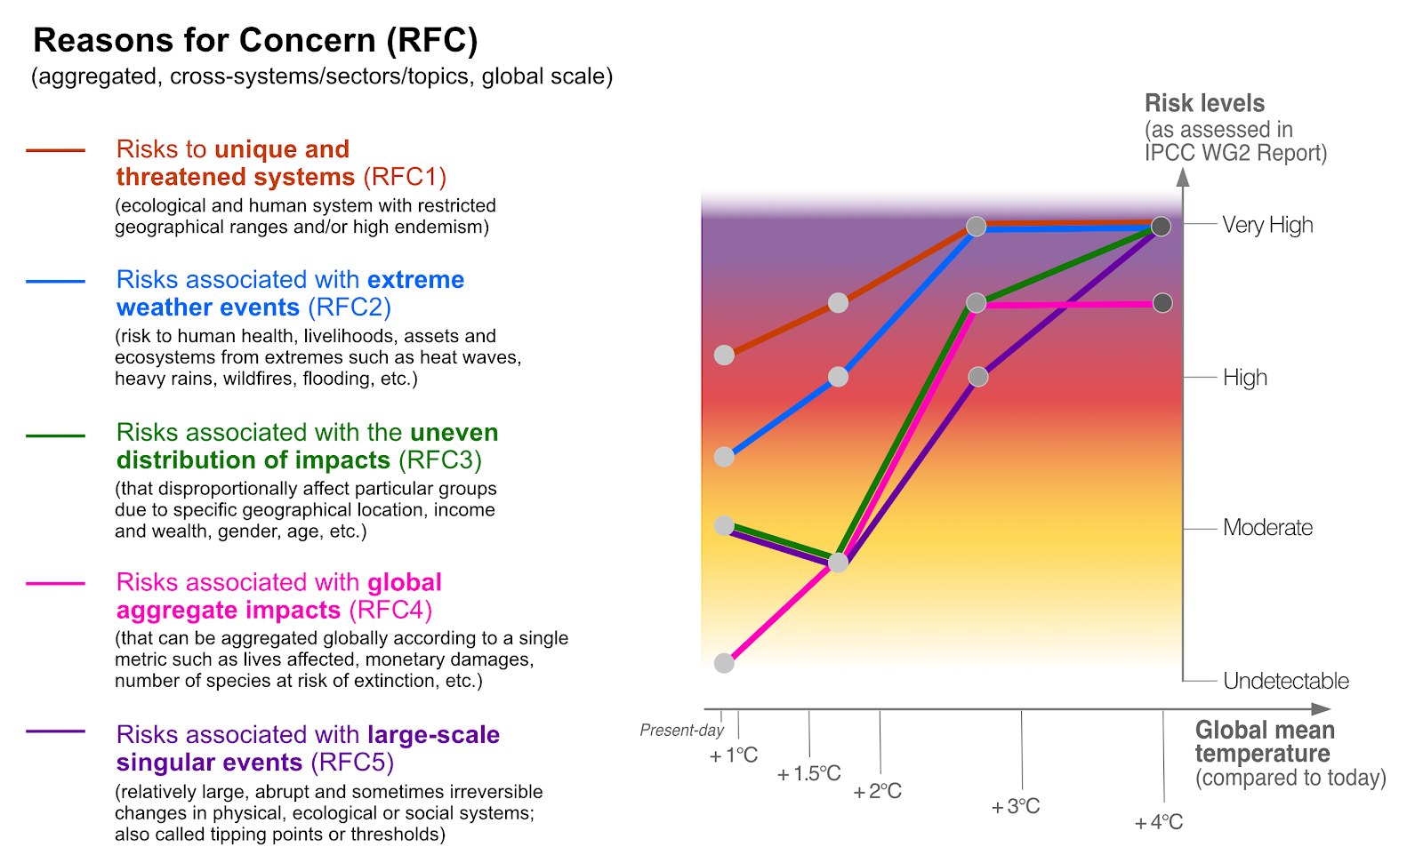
Climate Change Impacts
Human-induced climate change is causing dangerous and widespread disruption in nature
Urgent action is required to deal with increasing risks
Safeguarding and strengthening nature is key to securing a liveable future
Cities are hotspots of impacts and risks, but also a crucial part of the solution
Notes:
https://www.ipcc.ch/2022/02/28/pr-wgii-ar6/
https://www.iddri.org/en/publications-and-events/blog-post/what-does-recent-ipcc-report-say-about-imperative-adapt-climate

Slide 3
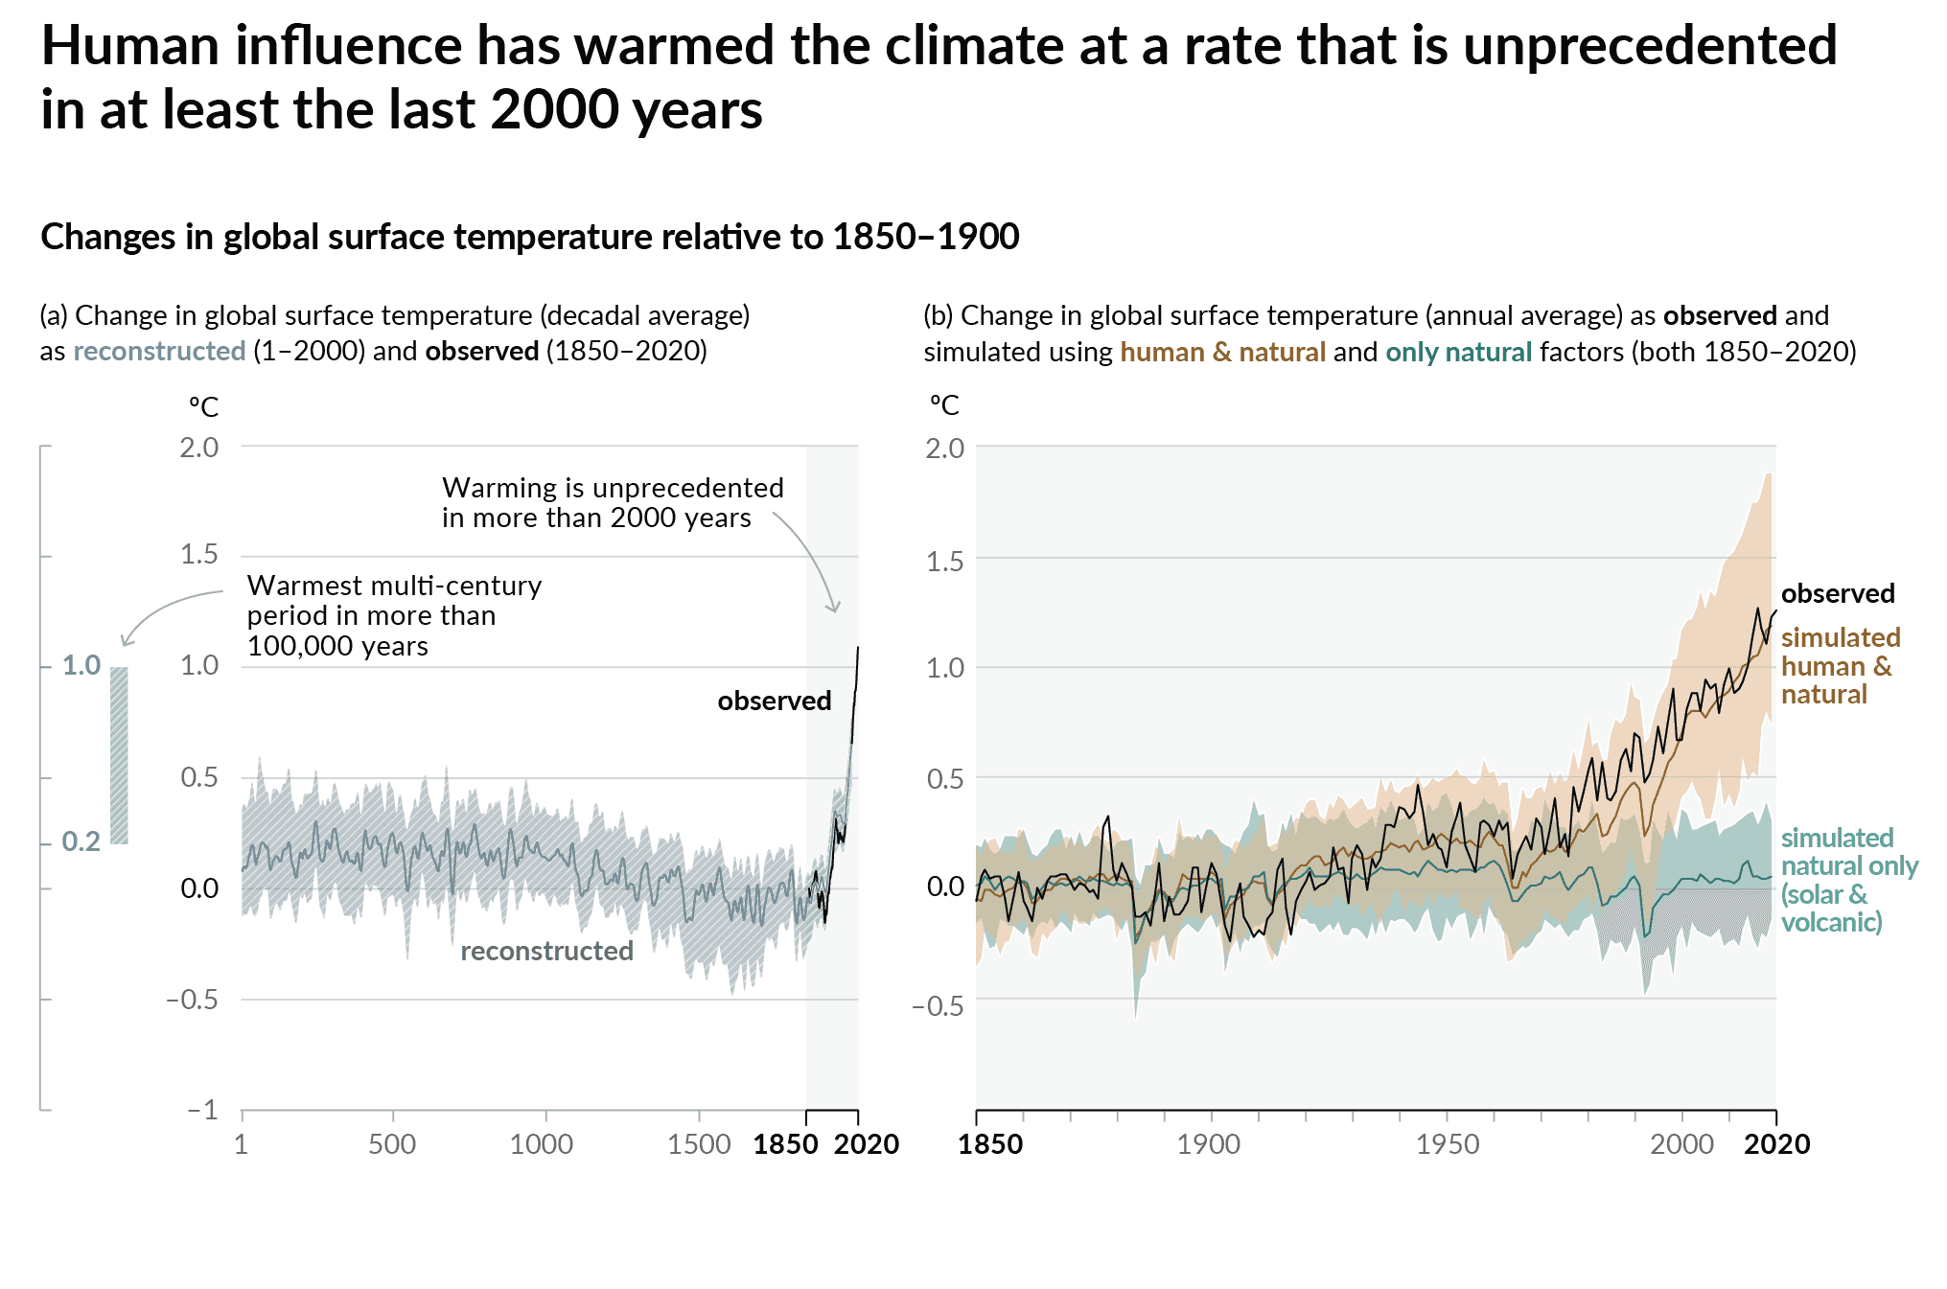
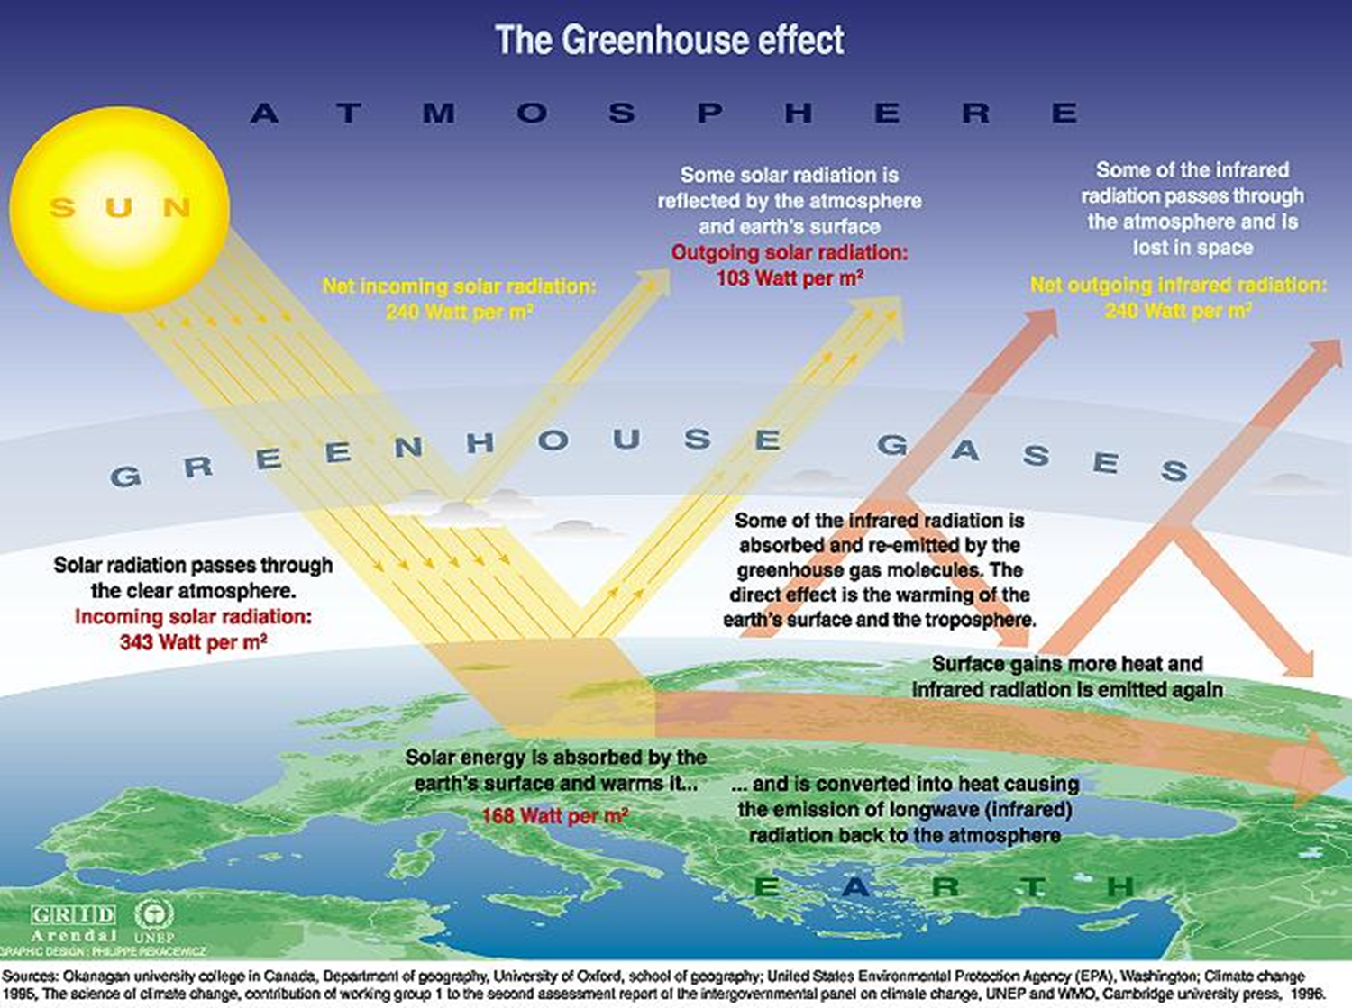
Greenhouse Effect
Notes:
Figure SPM.1 in IPCC, 2021: Summary for Policymakers. In: Climate Change 2021: The Physical Science Basis. Contribution of Working Group I to the Sixth Assessment Report of the Intergovernmental Panel on Climate Change [Masson-Delmotte, V., P. Zhai, A. Pirani, S.L. Connors, C. Péan, S. Berger, N. Caud, Y. Chen, L. Goldfarb, M.I. Gomis, M. Huang, K. Leitzell, E. Lonnoy, J.B.R. Matthews, T.K. Maycock, T. Waterfield, O. Yelekçi, R. Yu, and B. Zhou (eds.)]. Cambridge University Press, Cambridge, UK and New York, NY,USA, pp. 3−32, doi:10.1017/9781009157896.001.

Slide 4
UNFCCC Timeline
Notes:
https://unfccc.int/timeline/
The UNFCCC has two sister Conventions also agreed in Rio, the UN Convention on Biological Diversity and the Convention to Combat Desertification.
The seventh Conference of the Parties results in the Marrakesh Accords, setting the stage for ratification of the Kyoto Protocol. This would formalize agreement on operational rules for International Emissions Trading, the Clean Development Mechanism and Joint Implementation along with a compliance regime and accounting procedures.
At the twelfth Conference of the Parties held in Kenya, the Subsidiary Body for Scientific and Technological Advice SBSTA is mandated to undertake a programme to address impacts, vulnerability and adaptation to climate change - the Nairobi Work Programme NWP activities are ongoing.
The thirteenth Conference of the Parties adopts the Bali Road Map, including the Bali Action Plan, charting the course for a new negotiating process to address climate change. The Plan has five main categories: shared vision, mitigation, adaptation, technology and financing.
The sixteenth Conference of the Parties results in the Cancun Agreements, a comprehensive package by governments to assist developing nations in dealing with climate change. The Green Climate Fund, the Technology Mechanism and the Cancun Adaptation Framework are established.
At the seventeenth Conference of the Parties, governments commit to a new universal climate change agreement by 2015 for the period beyond 2020, leading to the launch of the Ad Hoc Working Group on the Durban Platform for Enhanced Action or ADP.
At the eighteenth Conference of the Parties, governments agree to speedily work toward a universal climate change agreement by 2015 and to find ways to scale up efforts before 2020 beyond existing pledges to curb emissions. They also adopt the Doha Amendment, launching a second commitment period of the Kyoto Protocol.
The nineteenth Conference of the Parties produces the Warsaw Outcomes, including a rulebook for reducing emissions from deforestation and forest degradation and a mechanism to address loss and damage caused by long-term climate change impacts.
https://blogs.worldbank.org/eastasiapacific/working-together-understand-climate-change-risks-fiji
https://www.herald.co.zw/cop-21-adopts-paris-agreement-but-little-cheer-for-africa/

Slide 5



Landmark Agreements
“Transforming our world: the 2030 Agenda for Sustainable Development” was adopted at the United Nations Sustainable Development Summit on 25 September 2015. They comprise 17 Sustainable Development Goals (SDG) and 169 targets, which are measured with 232 indicators.
The “Paris Agreement” was negotiated at the 21st Conference of the Parties (COP21) of the UNFCCC in Paris and adopted by consensus on 12 December 2015. It aims to keep global warming to “well below 2°C” compared to pre-industrial levels while also to "pursue efforts to" limit the temperature increase to 1.5 °C.
Notes:
Osesm-tuwien

Slide 6
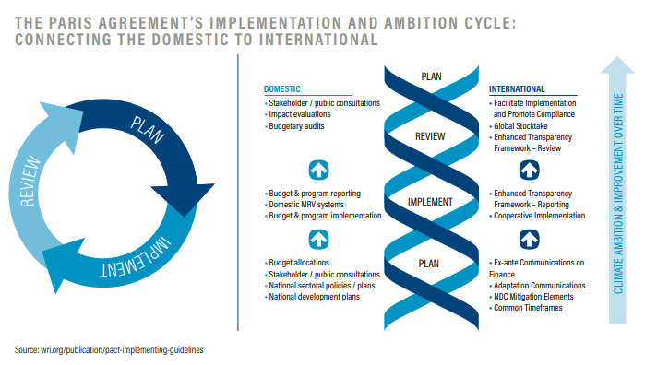
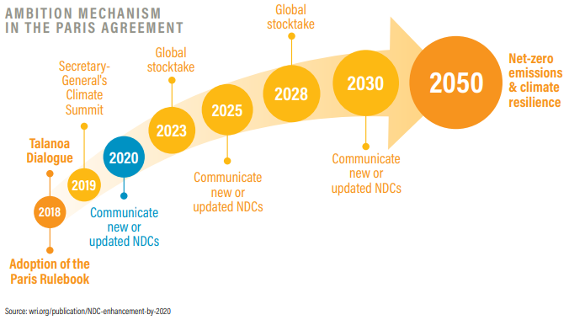
Paris Climate Agreement
Notes:
https://seors.unfccc.int/applications/seors/attachments/get_attachment?code=TY1H234DTG1HX0DK676QYVWQ8EDKKTH6

Slide 7
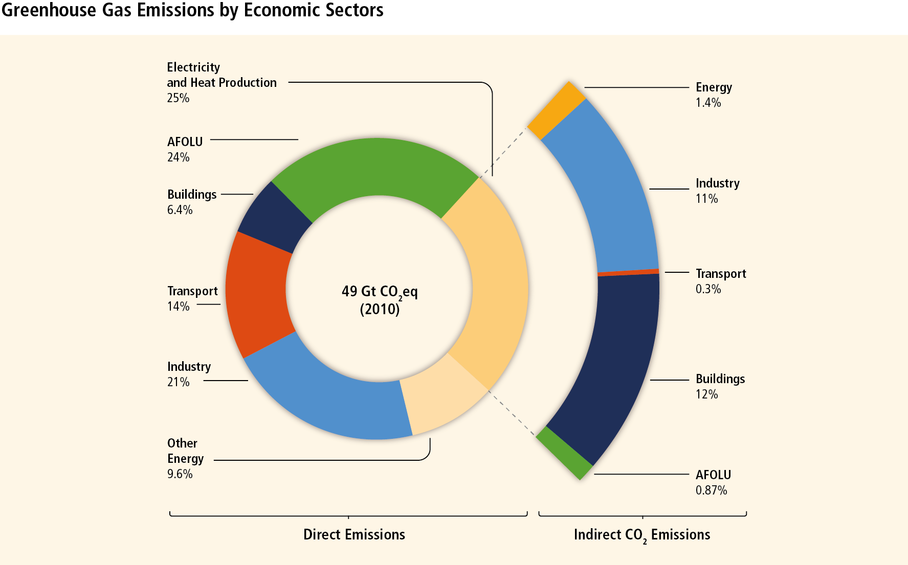
Emission Sources
Sources | Activities
Energy Supply | Electricity and centralized heat generation, resource extraction, and grid base transmission/distribution
Industry | Production of metals, pulp and paper, cement, and chemicals; petroleum refining
Forestry | Deforestation, decomposition of biomass that remains after logging
Agriculture | Crop and livestock production
Transport | Travel by car, freight truck, plane, train, or ship
Residential and Commercial Buildings | Heating, cooling, and electricity
Waste | Landfills, incineration, wastewater
Notes:
IPCC, 2022: Summary for Policymakers. In: Climate Change 2022: Mitigation of Climate Change. Contribution of Working Group III to the Sixth Assessment Report of the Intergovernmental Panel on Climate Change [P.R. Shukla, J. Skea, R. Slade, A. Al Khourdajie, R. van Diemen, D. McCollum, M. Pathak, S. Some, P. Vyas, R. Fradera, M. Belkacemi, A. Hasija, G. Lisboa, S. Luz, J. Malley, (eds.)]. Cambridge University Press, Cambridge, UK and New York, NY, USA. doi: 10.1017/9781009157926.001

Slide 8
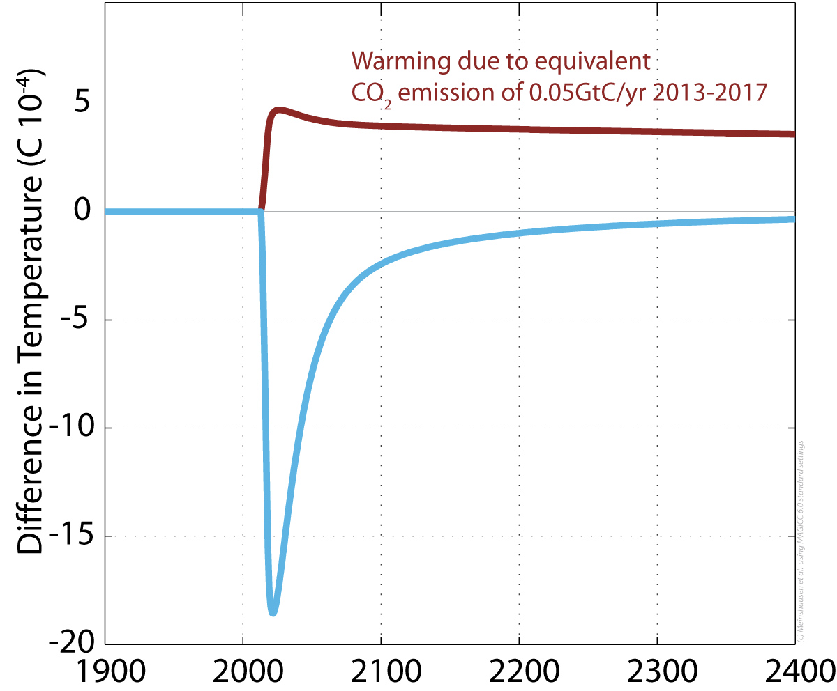
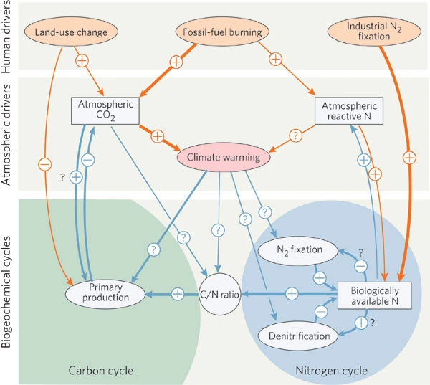
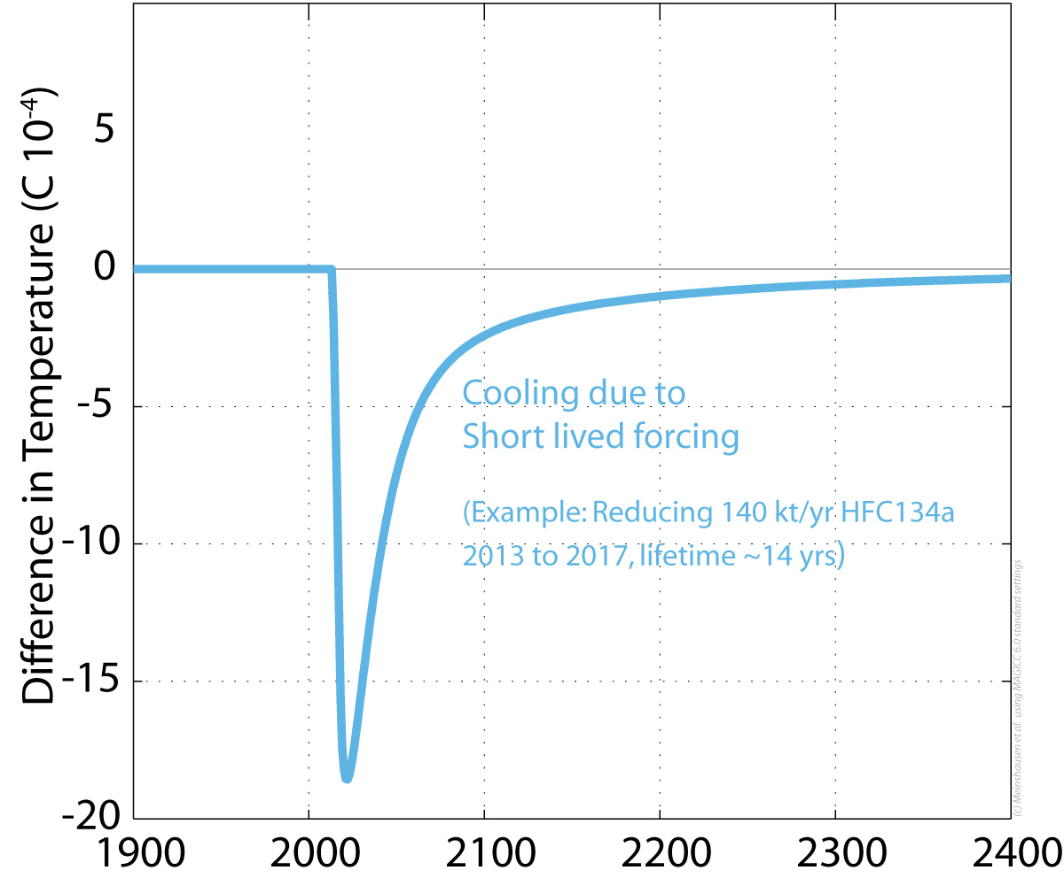
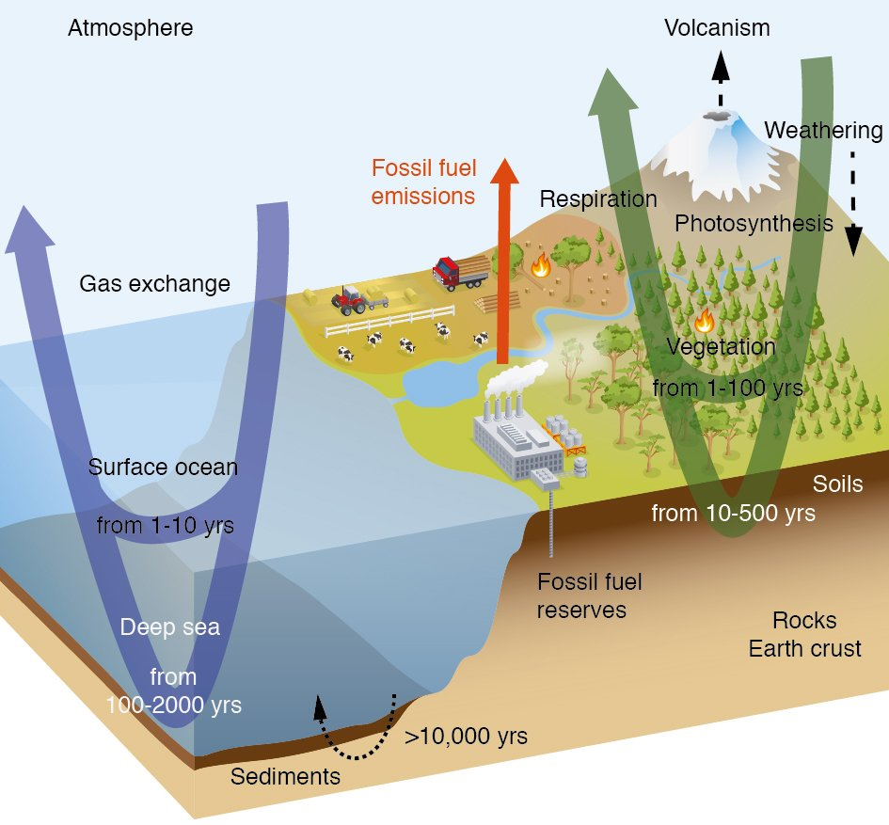
Greenhouse Gases
Global Warming Potential | 100-yr period
Carbon Dioxide | 1
Methane | 25
Nitrous Oxide | 298
Hydrofluorocarbons | 124 – 14,800
Perfluorocarbons | 7,390 – 12,200
Sulfur Hexafluoride | 22,800
Notes:
https://climateanalytics.org/briefings/why-using-20-year-global-warming-potentials-gwps-for-emission-targets-is-a-very-bad-idea-for-climate-policy/
Gruber, N., & Galloway, J. N. (2008). An Earth-system perspective of the global nitrogen cycle. Nature, 451(7176), 293–296. https://doi.org/10.1038/nature06592

Slide 9
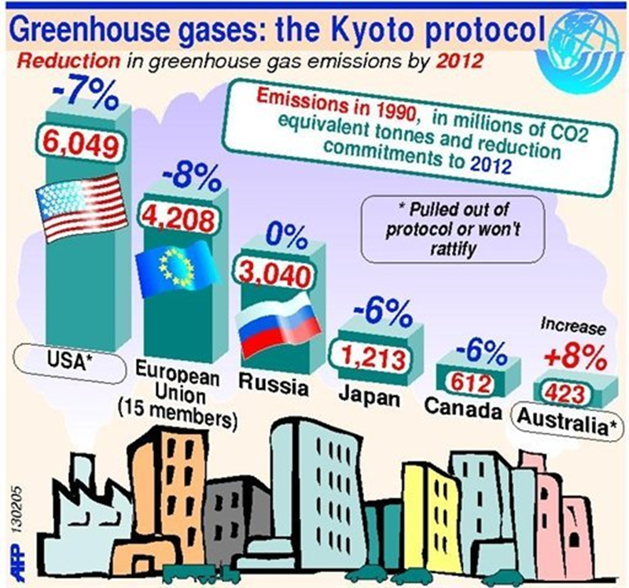
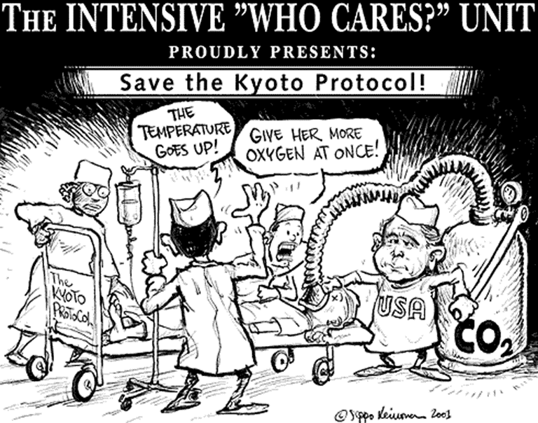
Kyoto Protocol

Slide 10
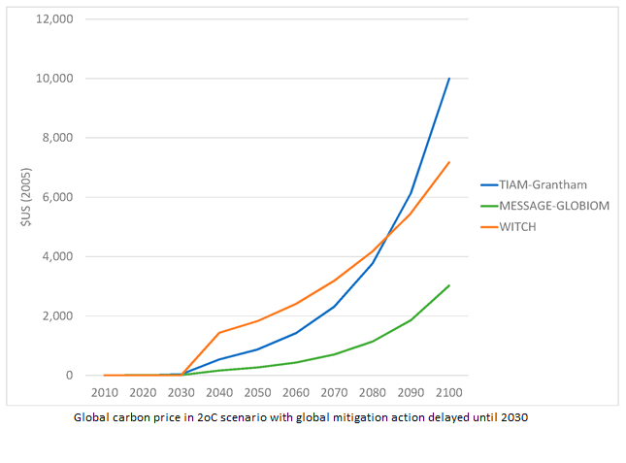
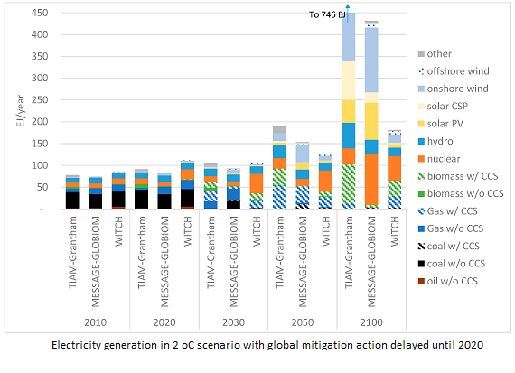
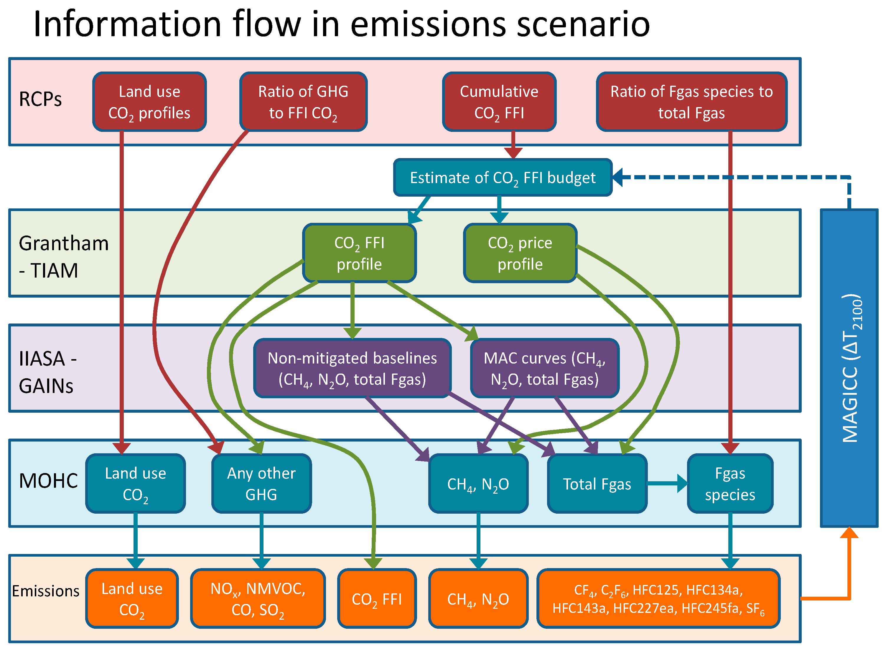
IPCC AR5 WGIII Mitigation of Climate Change
Climate scenarios based on narratives from socio-economic pathways (SSPs) with population and economic growth assumptions
Climate targets bound by feasibility limits as a result of:
Lack of mitigation options
Binding constraints for the diffusion of technologies
Extremely high price signals (such as rapid increases in carbon prices)
Notes:
Gambhir, A., Drouet, L., McCollum, D., Napp, T., Bernie, D., Hawkes, A., Fricko, O., Havlik, P., Riahi, K., Bosetti, V., Lowe, J., Havlik, P., Bernie, D., Drouet, L., Napp, T., Gambhir, A., Fricko, O., McCollum, D., Bosetti, V., … Lowe, J. (2017). Assessing the Feasibility of Global Long-Term Mitigation Scenarios. Energies, 10(1), 89. https://doi.org/10.3390/en10010089

Slide 11
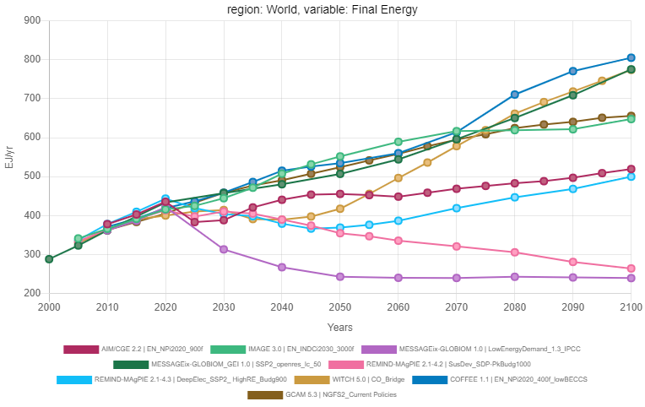
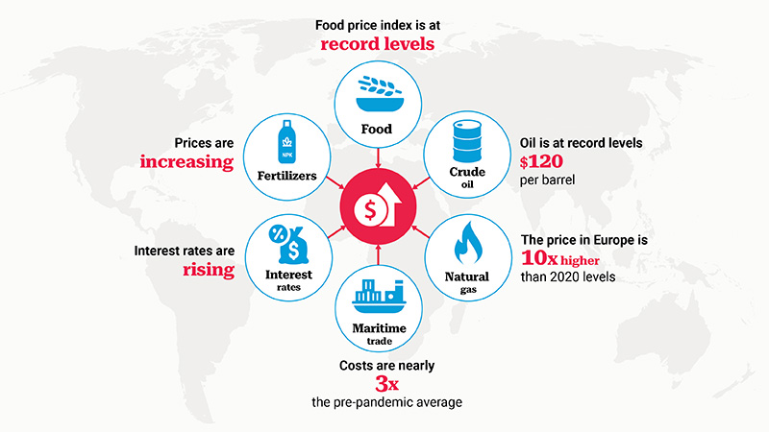

IPCC AR5 WGIII Mitigation of Climate Change
First IPCC report to provide in-depth assessment of how behaviour, choices and consumption can contribute to climate mitigation
Ambitious targets require carbon sequastration by land and ocean sinks
Climate targets are at a higher risk since the Russian invasion of Ukraine
Requires re-elaboration of climate scenarios and projections based on climate narratives
Notes:
https://unctad.org/news/war-ukraine-threatens-unleash-unprecedented-wave-global-hunger-and-destitution
Byers, Edward, Krey, Volker, Kriegler, Elmar, Riahi, Keywan, Schaeffer, Roberto, Kikstra, Jarmo, Lamboll, Robin, Nicholls, Zebedee, Sandstad, Marit, Smith, Chris, van der Wijst, Kaj, Lecocq, Franck, Portugal-Pereira, Joana, Saheb, Yamina, Stromann, Anders, Winkler, Harald, Auer, Cornelia, Brutschin, Elina, Lepault, Claire, … Skeie, Ragnhild. (2022). AR6 Scenarios Database (1.0) [Data set]. Zenodo. https://doi.org/10.5281/zenodo.5886912

Slide 12
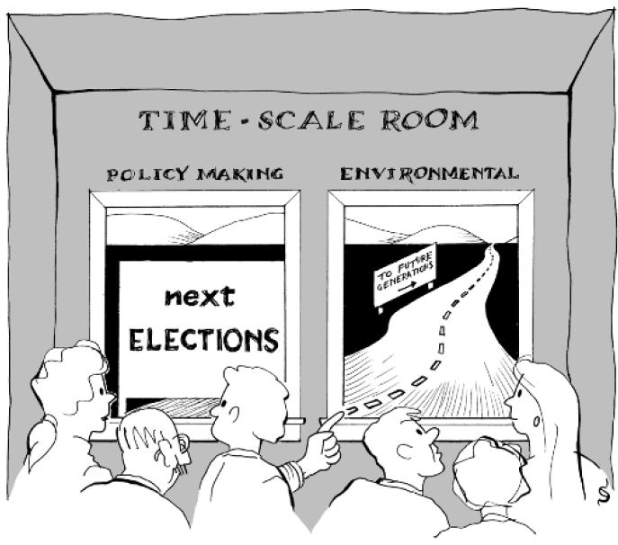
Energy Policy
Economic productivity
Oil supply vulnerability
Systems reliability
Managing environmental change
Controlling extreme events
Continuity depending on time-scale
Notes:
Uğur Soytaş

Slide 13
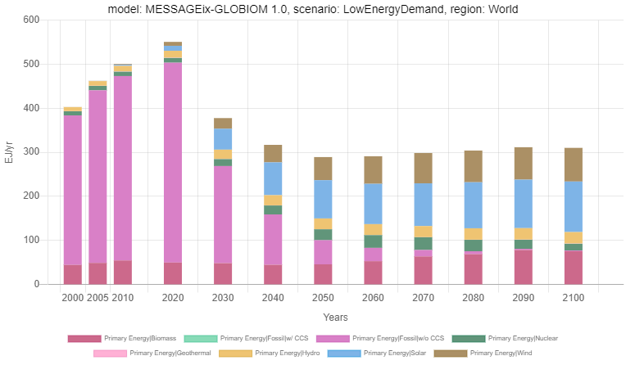
IPCC SR15 Global Warming of 1.5ºC
Global warming is likely to reach 1.5°C between 2030 and 2052
Climate models project robust differences in regional climate characteristics between present-day and global warming of 1.5°C, and between 1.5°C and 2°C
Significant near-term emissions reductions and measures to lower energy and land demand can limit CDR deployment to a few hundred GtCO2 without reliance on BECCS
Notes:
https://www.ipcc.ch/site/assets/uploads/sites/2/2019/06/SR15_Headline-statements.pdf
https://data.ece.iiasa.ac.at/iamc-1.5c-explorer/#/workspaces/2

Slide 14
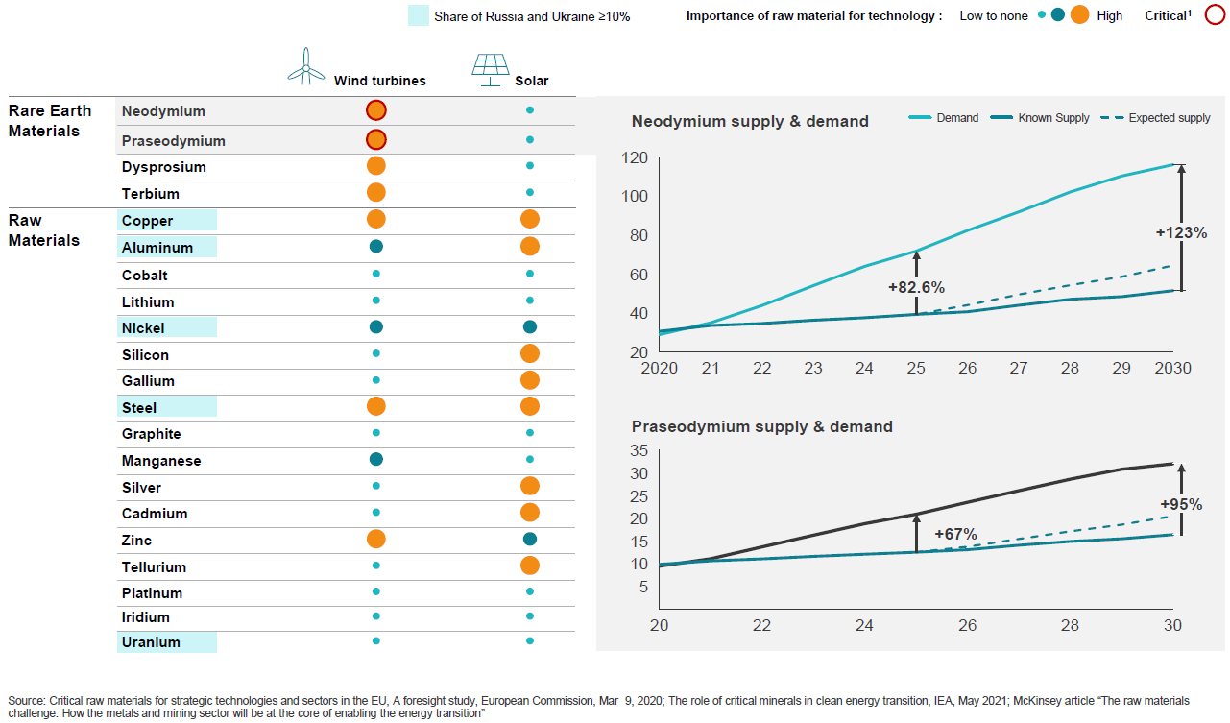
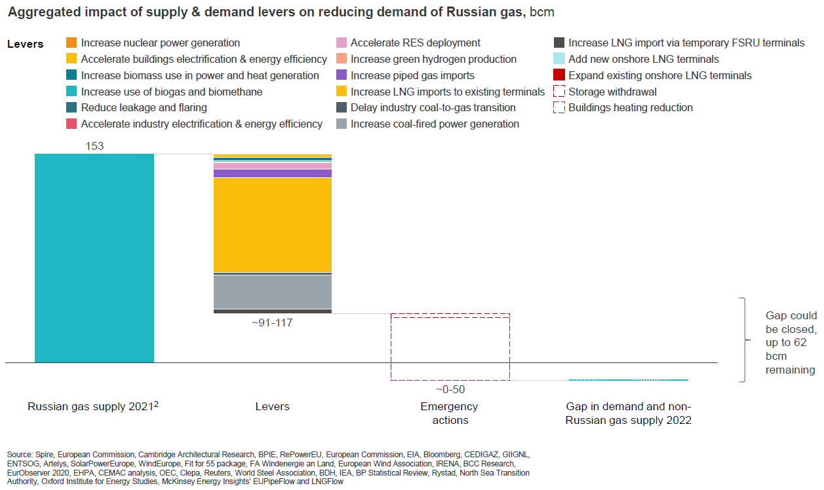
Energy Crises in the European Union
Risks of supply shortages are real.
No amount of alternative gas imports can offset them.
Actions to evade the crises:
Extraordinary energy savings schemes,
Shutdown of some industrial facilities,
Alternative supplies, fuel switching,
Rapid deployment of clean energy solutions, heat pumps and home renovations.
Notes:
https://europeanclimate.org/resources/delivering-eu-energy-security-through-climate-action/

Slide 15
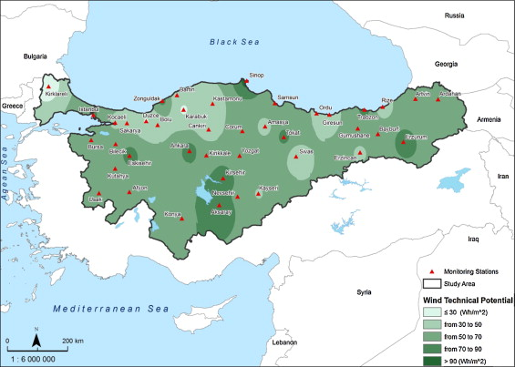
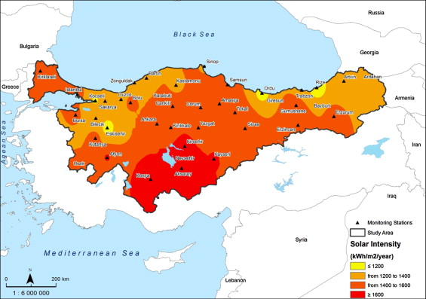
Renewable Energy
Geographical advantage increasing its potential on renewable energy sources.
2023 targets include putting 3000 MW solar and 20,000 MW wind power capacity in operation.
The main policy priority relies on the support of local wind terminal and solar panel production.
Energy available to consumers in a cost efficient, timely manner meeting the demand.
Notes:
Basaran, S. T., Dogru, A. O., Balcik, F. B., Ulugtekin, N. N., Goksel, C., & Sozen, S. (2015). Assessment of renewable energy potential and policy in Turkey – Toward the acquisition period in European Union. Environmental Science & Policy, 46, 82–94. https://doi.org/10.1016/j.envsci.2014.08.016

Slide 16
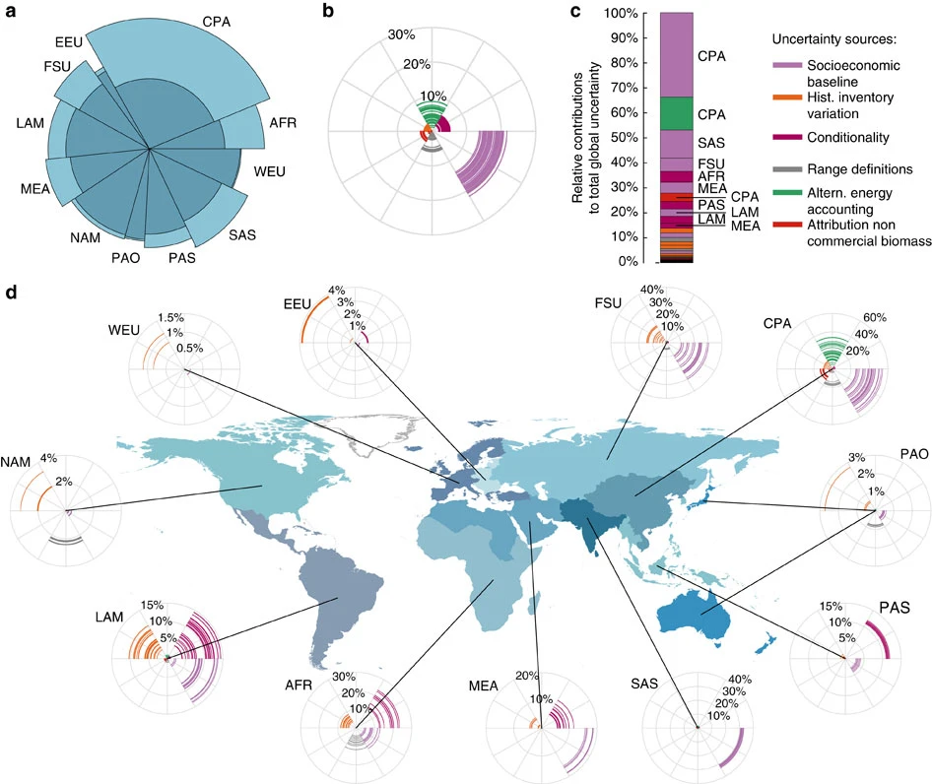
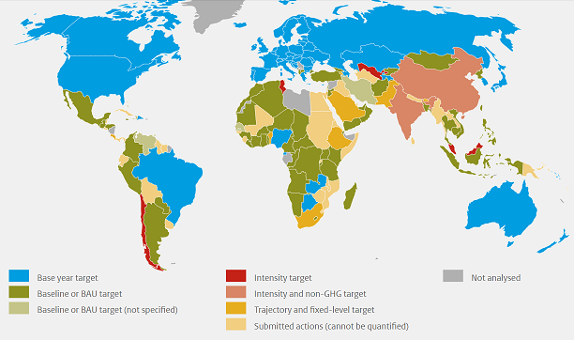
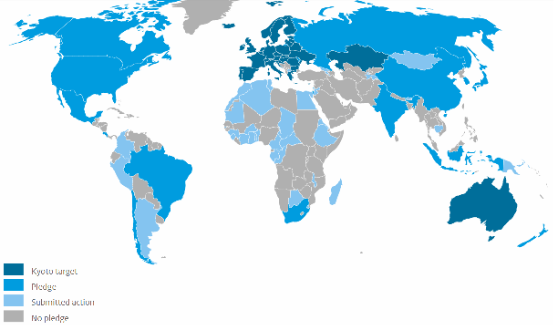
NDC Targets
The costs for achieving the 2ºC climate target are at least 3 – 3.5 times higher in 2030 than conditional NDCs
Costs of NDC targets depends on SSP assumptions and could be reduced substaintially by global flexibility mechanisms (emissions trading)
Some uncertainties can be reduced with technical clarifications (accounting), other are the result of politically valid choices
(a) Regional emissions contributions to global emissions and uncertainty under the full implementation of current NDCs. Shadings show the minimum–maximum range of emissions estimates per region; (b) Estimates of the magnitude of uncertainty induced in 2030 per source relative to the median estimate; (c) Average contribution to full uncertainty range in 2030 per uncertainty source with the 10 most important contributions identified by region; (d) As b but per geographical region. AFR, Sub-Saharan Africa; CPA, Centrally Planned Asia and China; EEU, Central and Eastern Europe; FSU, Former Soviet Union; LAM, Latin America and the Caribbean; MEA, Middle East and North Africa; NAM, North America; PAS, Pacific OECD; SAS, South Asia; PAS, Other Pacific Asia; WEU, Western Europe. Country borders use the simplified TM World borders, provided by Bjorn Sandvik (thematicmapping.org).
Notes:
https://themasites.pbl.nl/o/climate-ndc-policies-tool/
Hof, A. F., den Elzen, M. G. J., Admiraal, A., Roelfsema, M., Gernaat, D. E. H. J., & van Vuuren, D. P. (2017). Global and regional abatement costs of Nationally Determined Contributions (NDCs) and of enhanced action to levels well below 2 °C and 1.5 °C. Environmental Science & Policy, 71, 30–40. https://doi.org/10.1016/j.envsci.2017.02.008
Rogelj, J., Fricko, O., Meinshausen, M., Krey, V., Zilliacus, J. J. J., & Riahi, K. (2017). Understanding the origin of Paris Agreement emission uncertainties. Nature Communications, 8(1), 15748. https://doi.org/10.1038/ncomms15748

Slide 17
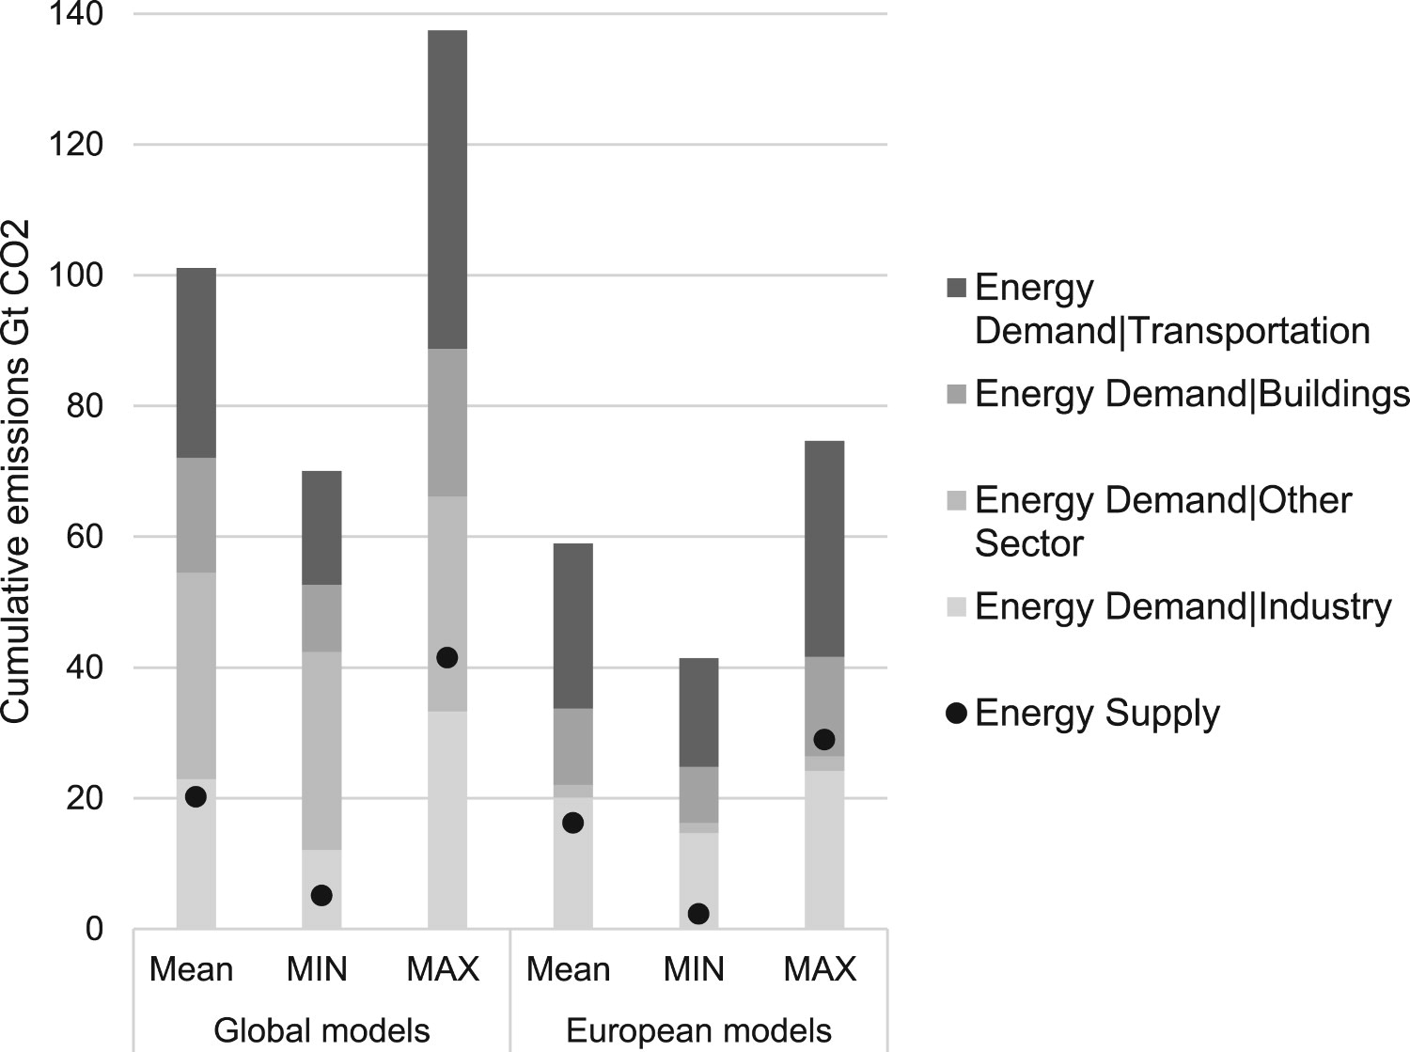
NDCs of Major Emitters – European Union
Emissions reduction objectives achieved through a combination of national reduction targets in each Member State and the use of EU ETS
Import fossil fuel prices projected to increase by more than 50% in 2010-2030
Carbon emission reduction efforts should scale up with mitigation strategies in the end-use sectors with negative emission technologies
 | Official 2030 INDC target | Official targets to implement the EU INDC (Climate Policy Framework) | Targets and policies implemented in model | Driving instruments used in the model to reach the targets
GHGs emissions reduction | -EU-wide GHG reduction by 40% relative to 1990 levels | -EU-wide GHG reduction by 40% compared to 1990 levels | All emission targets defined by the 2030 energy and climate policy Framework are explicitly incorporated in PRIMES | -Carbon price for ETS sectors
 |  | -Reduction of 43% (from 2005) in ETS sectors |  | -Policies and measures for non-ETS sectors
 |  | -Reduction of 30% in non-ETS sectors (from 2005) |  | -Market Stability Reserve
 |  |  |  | -Auction/Free allocation of allowances
 | Official targets to implement the EU INDC (Climate Policy Framework) | Targets and policies implemented in model | Driving instruments used in the model to reach the targets
Energy efficiency | -27% efficiency improvement by 2030 (indicative target at the EU level) | Energy efficiency target is implemented in PRIMES | -Regulations (Eco-design measures, Buildings Directive, Energy Efficiency Directive)
 |  |  | -CO2 standards for cars
 |  |  | -Carbon value in non-ETS sectors
Renewables | -27% RES share in EU gross final energy demand in 2030 (binding) | RES share target is imposed in the model | -Regulations
 |  |  | -National support schemes
 |  |  | -Carbon price
Minimum, mean and maximum cumulative emissions by energy sector for the evaluated scenarios for 2015–2050
Notes:
Fragkos, P., Fragkiadakis, K., Paroussos, L., Pierfederici, R., Vishwanathan, S. S., Köberle, A. C., Iyer, G., He, C.-M. M., & Oshiro, K. (2018). Coupling national and global models to explore policy impacts of NDCs. Energy Policy, 118, 462–473. https://doi.org/10.1016/j.enpol.2018.04.002
Duscha, V., Denishchenkova, A., & Wachsmuth, J. (2019). Achievability of the Paris Agreement targets in the EU: demand-side reduction potentials in a carbon budget perspective. Climate Policy, 19(2), 161–174. https://doi.org/10.1080/14693062.2018.1471385

Slide 18
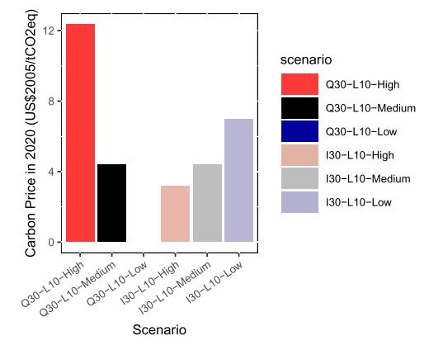
NDCs of Major Emitters – China
China has the largest population and is the biggest emitter of CO2 in the world
The share of services sector in GDP is projected to increase to 56% in 2050 from 40% in 2010
Based on the historical progress, there is high opportunity to go beyond the 60% to 65% target
Emissions and intensity targets can have both synergies and also trade-offs depending on uncertainties
 | Official 2030 INDC target (conditional or unconditional) | Official targets to implement the Country INDC | Targets and policies implemented in model | Driving instruments used in the model to reach the targets
GHGs emissions reduction | Peak CO2 emission around 2030, and try to peak earlier, carbon intensity decline by 60% to 65% in 2030 compared to 2005 | No 2030 target, 18% carbon intensity for 2020 compared with that in 2015 | 40% carbon intensity by 2020 relative to 2005, used in the INDC scenario, and 52% carbon intensity by 2020 for 2 degree scenario | Coal control policy for air pollution improvement action plan
 | Official 2030 INDC target (conditional or unconditional) | Official targets to implement the Country INDC | Targets and policies implemented in model | Driving instruments used in the model to reach the targets
Renewables | 20% non-fossil fuel in total primary energy demand in 2030 | 100 to 150 GW for solar PV by 2020, 200 to 300GW for wind power by 2020, 58GW of nuclear by 2020, 100GW to 150GW of nuclear by 2030 | Lower end of renewable energy target by 2020 for INDC scenario (100 GW for solar, 200GW for wind) | Subsidies for renewable energy, National target for nuclear power
Notes:
Fragkos, P., Fragkiadakis, K., Paroussos, L., Pierfederici, R., Vishwanathan, S. S., Köberle, A. C., Iyer, G., He, C.-M. M., & Oshiro, K. (2018). Coupling national and global models to explore policy impacts of NDCs. Energy Policy, 118, 462–473. https://doi.org/10.1016/j.enpol.2018.04.002
Giannousakis, A., Baumstark, L., & Kriegler, E. (2020). En route to China’s mid-century climate goal: comparison of emissions intensity versus absolute targets. Climate Policy, 20(10), 1274–1289. https://doi.org/10.1080/14693062.2020.1798734

Slide 19
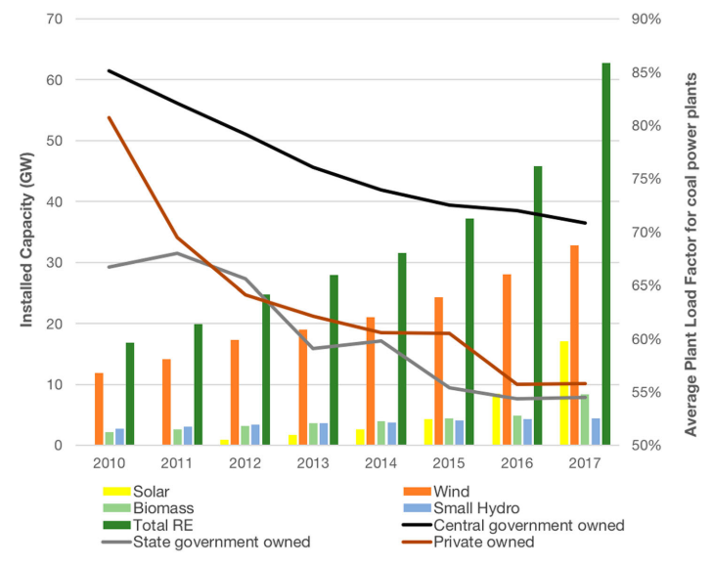
NDCs of Major Emitters – India
 | Official 2030 INDC target (conditional or unconditional) | Official targets to implement the Country INDC | Targets and policies implemented in model | Driving instruments used in the model to reach the targets
Power | Unconditional | AT&C losses: Reduce to 6-8%, introduction of smart and micro grids | This measure is implemented in the model | National Mission for Enhanced Energy Efficiency (NMEEE)
Industry | Conditional - This is a sectoral policy | Eenhanced sectoral and plant coverage,railway, refineries and distributed companies | Policies and measure implemented in the model | National Mission for Enhanced Energy Efficiency (NMEEE)
Transportation | Unconditional | Share of railways: 36 to 45 %, introduction of DFC, improve vehicle efficiency, introduce EV, increase public transit (metro) | Policies and measure implemented in the model | National Mission on Sustainable Habitats, Smart Cities Mission, Atal Mission for Rejuvenation and Urban Transformation (AMRUT)
 | Official 2030 INDC target (conditional or unconditional) | Official targets to implement the Country INDC | Targets and policies implemented in model | Driving instruments used in the model to reach the targets
GHGs emissions reduction | Conditional (Voluntary pledge) -Emission intensity reduction by 33-35 per cent from 2005 level | Emission intensity reduction by 33-35 per cent from 2005 level during 2005-2030 | The emission intensity target is explicitly included in the model | Standards and regulations in implemented in industry, residential, commercial and transport sectors
Renewables | Conditional (Voluntary pledge) -40 per cent non-fossil fuels/ renewables (cumulative installed power capacity) | 40% non-fossil fuels/renewables -Renewable capacity Solar: 100 GW by 2030, Wind: 60 GW by 2022, Small hydro: 15 GW by 2022, Biomass: 25 GW by 2022 | The RES capacity target is found to be more stringent than the GHG intensity target | -National Solar and Wind Missions, Biofuel Policy, Renewable Purchase Obligations (RPOs), Tariff for solar and biogas power
 | Official 2030 INDC target (conditional or unconditional) | Official targets to implement the Country INDC | Targets and policies implemented in model | Driving instruments used in the model to reach the targets
Residential and Commercial | Unconditional | LED to save 100 TWh annually, Standards and Labelling programme for 21 equipment, LEED and ECBC std. | Policies and measure implemented in the model | National Mission on Sustainable Habitats, NSM, NMEEE, Standards and Labelling programme
Agriculture | Unconditional | Shifting to energy efficient pumps and solar pumps | Policies and measure implemented in the model | NSM, NMEEE
Multi-sectoral pledges for energy and emission intensity targets
Although India is on track for emission reduction, there are uncertainties related to post-2030 energy policy
The targets are modest compared to the potential and might be improved to increase the climate ambition
Notes:
Fragkos, P., Fragkiadakis, K., Paroussos, L., Pierfederici, R., Vishwanathan, S. S., Köberle, A. C., Iyer, G., He, C.-M. M., & Oshiro, K. (2018). Coupling national and global models to explore policy impacts of NDCs. Energy Policy, 118, 462–473. https://doi.org/10.1016/j.enpol.2018.04.002
Mohan, A., & Wehnert, T. (2019). Is India pulling its weight? India’s nationally determined contribution and future energy plans in global climate policy. Climate Policy, 19(3), 275–282. https://doi.org/10.1080/14693062.2018.1503154

Slide 20
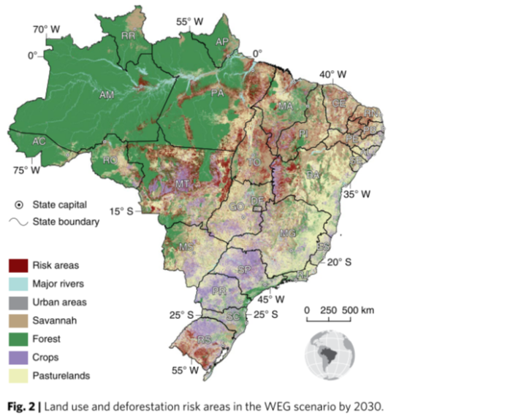
NDCs of Major Emitters – Brazil
 | Official 2030 INDC target (please specify if conditional or unconditional) | Targets and policies implemented in model | Driving instruments used in the model to reach the targets
GHGs emissions reduction | Unconditional targets | Net zero deforestation in 2030, full implementation of the Low Carbon Agriculture plan by 2025 done exogenously, biofuel target met through C tax, infrastructure target too vague for model implementation | Carbon price of $50/tCO2eq introduced starting in 2020
Primary Energy | 45% of primary energy supply from RES
Power generation | Non-hydro renewables at least 23% by 2030, 10% efficiency gains by 2030, promote efficiency measures
Transportation | Improve public transport infrastructure, promote new standards of clean technology, enhance efficiency measures and low-carbon infrastructure
Agriculture | Strengthen Low Carbon Agriculture plan
One of the cleanest energy systems and a low-carbon energy mix based on hydropower for electricity
The transport sector remains a major source of GHG emissions
Trade-offs for biofuel: energy resources (land use change and deforestation) vs. agricultural commodity markets (export of soybeans)
Notes:
Fragkos, P., Fragkiadakis, K., Paroussos, L., Pierfederici, R., Vishwanathan, S. S., Köberle, A. C., Iyer, G., He, C.-M. M., & Oshiro, K. (2018). Coupling national and global models to explore policy impacts of NDCs. Energy Policy, 118, 462–473. https://doi.org/10.1016/j.enpol.2018.04.002
Paim, M. A., Salas, P., Lindner, S., Pollitt, H., Mercure, J. F., Edwards, N. R., & Viñuales, J. E. (2020). Mainstreaming the Water-Energy-Food Nexus through nationally determined contributions (NDCs): the case of Brazil. Climate Policy, 20(2), 163–178. https://doi.org/10.1080/14693062.2019.1696736
Rochedo, P. R. R. R., Soares-Filho, B., Schaeffer, R., Viola, E., Szklo, A., Lucena, A. F. P. P., Koberle, A., Davis, J. L., Rajão, R., & Rathmann, R. (2018). The threat of political bargaining to climate mitigation in Brazil. Nature Climate Change, 8(8), 695–698. https://doi.org/10.1038/s41558-018-0213-y

Slide 21
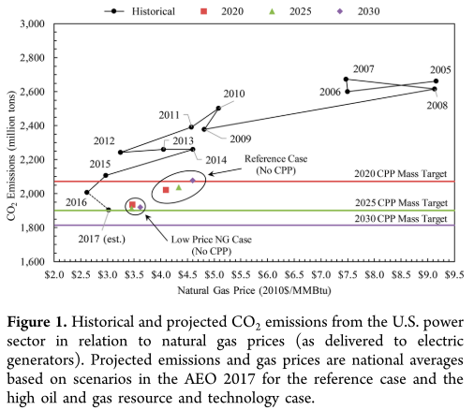
NDCs of Major Emitters – United States
The Clean Power Plan includes fuel economy standards for light and heavy duty vehicles, limits on methane emissions, and building energy efficiency standards
Carbon emissions already declined with efficiency improvements and fuel substitution (natural gas for coal)
Political identities (liberal vs. conservative – Democrat vs. Republican) may influence public support for policies
 | Official 2025 INDC target | Official targets to implement the Country INDC | Targets and policies implemented in model | Driving instruments used in the model to reach the targets
GHGs emissions reduction | Unconditional target | Sector-specific emissions reductions policies | 17% below 2005 levels in 2020 and 26-28% below 2005 levels in 2025. | Emissions constraint covering all GHG emissions represented in GCAM-USA
Renewables | No specific target is included in INDC |  | ITC and PTC to incentivize deployment of renewables | Subsidies for renewables to model the ITC and PTC
Power supply |  |  | Performance standards | Coal power moratorium
Notes:
Fragkos, P., Fragkiadakis, K., Paroussos, L., Pierfederici, R., Vishwanathan, S. S., Köberle, A. C., Iyer, G., He, C.-M. M., & Oshiro, K. (2018). Coupling national and global models to explore policy impacts of NDCs. Energy Policy, 118, 462–473. https://doi.org/10.1016/j.enpol.2018.04.002
Anderson, J. J., Rode, D., Zhai, H., & Fischbeck, P. (2018). Will We Always Have Paris? CO 2 Reduction without the Clean Power Plan. Environmental Science & Technology, 52(5), 2432–2433. https://doi.org/10.1021/acs.est.8b00407
Mayer, A. (2019). National energy transition, local partisanship? Elite cues, community identity, and support for clean power in the United States. Energy Research and Social Science, 50(July 2018), 143–150. https://doi.org/10.1016/j.erss.2018.11.020

Slide 22
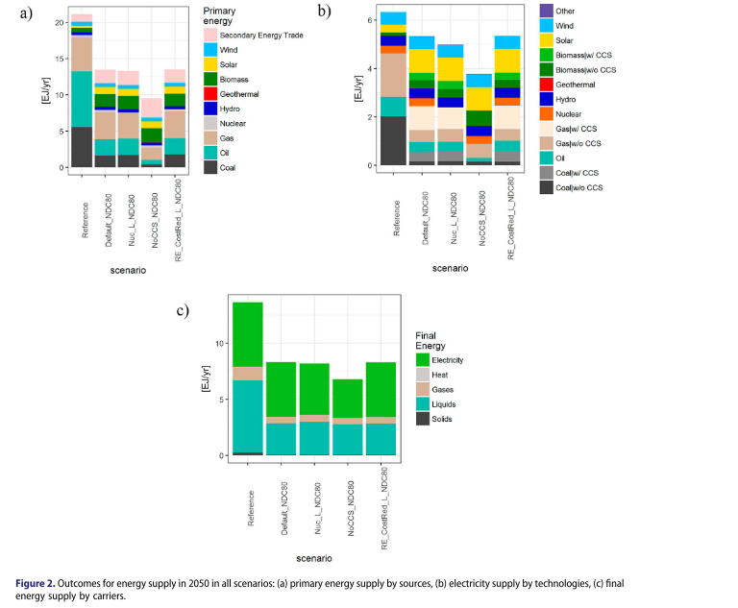
NDCs of Major Emitters – Japan
The switch from coal to gas fired plants and renewable energies, such as solar PV and biomass, is the key option in order to reduce emission intensity of electricity by 2030
Vertically integrated electricity market prevents renewable energy penetration
Nuclear and carbon capture and storage may not be available due to natural disaster risks (earthquakes)
 | Official 2030 INDC target | Official targets to implement the Country INDC | Targets and policies implemented in model | Driving instruments used in the model to reach the targets
GHGs emissions reduction | Unconditional target | GHG reduction by 26% below 2013, 25.4% below 2005 | 22.7% reduction by 2030 compared to 2005 | Implicit carbon prices for all sectors
Renewables |  | 22-24% of electricity generation | Official INDC target for RES share | Implicit carbon prices
Nuclear |  | 20-22% of electricity generation | 232 TWh in 2030 | Constraint on the capacity of nuclear power plants
Final energy demand |  | 10% reduction compared to 2013 | Determined by model optimization | Implicit carbon prices for all demand sectors
Notes:
Silva Herran, D., Fujimori, S., & Kainuma, M. (2019). Implications of Japan’s long term climate mitigation target and the relevance of uncertain nuclear policy. Climate Policy, 19(9), 1117–1131. https://doi.org/10.1080/14693062.2019.1634507

Slide 23
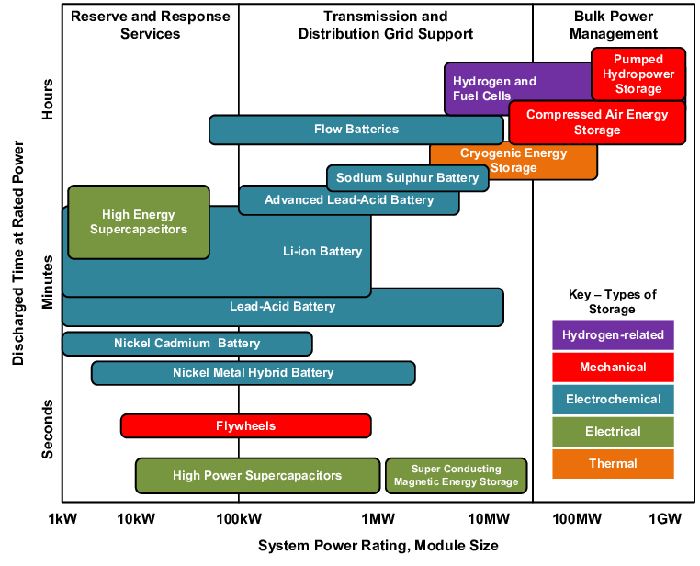
Electrical Energy Storage
Pumped hydropower storage (PHS)
Compressed air energy storage (CAES)
Flywheels
Electrochemical batteries (e.g. lead–acid, NaS, Ni–Cd, and Li-ion)
Superconducting magnetic energy storage (SMES)
Supercapacitor energy storage (SCES)
Hydrogen energy storage (Power-to-Gas)
Notes:
Sprake, D., Vagapov, Y., Lupin, S., & Anuchin, A. (2017). Housing estate energy storage feasibility for a 2050 scenario. 2017 Internet Technologies and Applications (ITA), September, 137–142. https://doi.org/10.1109/ITECHA.2017.8101925

Slide 24
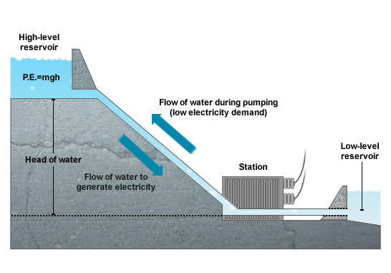
Pumped hydropower storage (PHS)
Global installed capacity of 125 GW representing 3% of total capacity
First commercially proven large scale energy storage technology
Environmental concerns and scarcity of favorable sites may increase the capital cost of projects

Slide 25
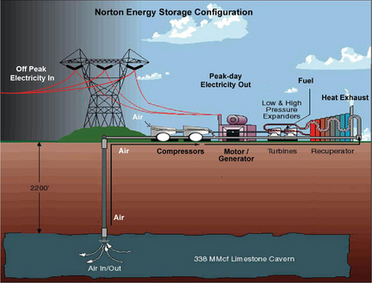
Compressed air energy storage (CAES)
Second commercially proven large-scale energy storage technology
Currently there are two commercial CAES plants worldwide; the Huntorf plant in Germany and the McIntosh plant in Alabama
Overall efficiency is approximately 42% which can be improved by 12% by recovering the waste heat
Costs are site specific and depend strongly on the geology
Notes:
http://www.eseslab.com/ESsensePages/CAES-page

Slide 26
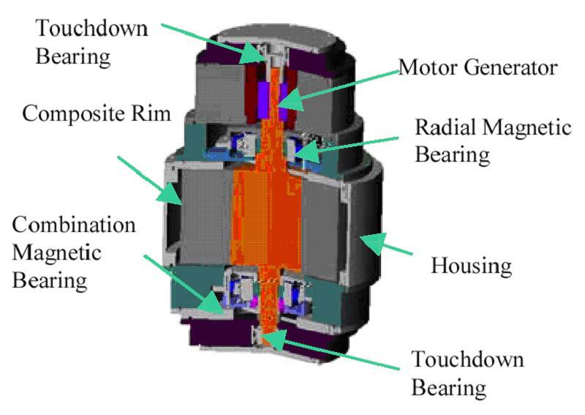
Flywheels
Mature technology used as power buffer in electric vehicles
Fast response time make them suitable for:
Short term response for frequency regulation (20 MW frequency regulation plant in Stephen-town, New York)
Switching between different types of power sources (A wind-hydrogen plant in Utsira in Norway is equipped with a 200 kW flywheel to store 5 kWh for a few seconds)

Slide 27
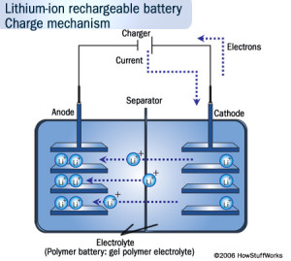
Electrochemical batteries
Lead–acid batteries are not favorable for energy-shift operations
NaS batteries are one of the most proven electrochemical storage technologies in MW scale (606 MW global installed capacity by 2012)
Ni–Cd battery have high capital costs and environmental problems
Lithium-ion first targeted for portable application but also deployed in grid-scale applications (Laurel Mountain Wind Farm, in Ohio, with 32 MW enhancing wind power plant flexibility)

Slide 28
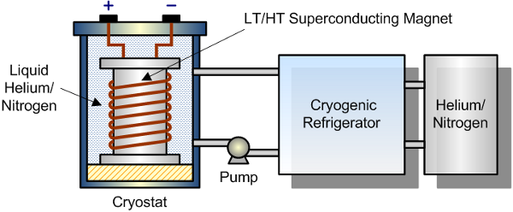
Superconducting magnetic energy storage (SMES)
Characterized by very high energy storage efficiency (~97%), fast response (few ms), and long life cycles (100 000)
Recent development has mostly been on smaller scale applications and systems up to 10 MW with the advancement of superconductor technology
US DoE has awarded grants for research in grid-scale applications

Slide 29
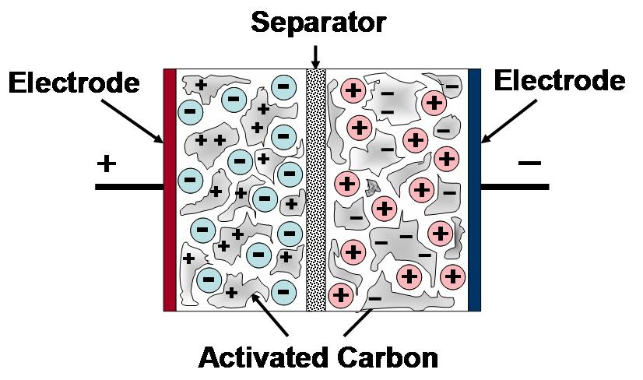
Supercapacitor energy storage (SCES)
Fast-response with life cycles of tens of thousands and very high efficiency
The main drawback are short storage duration, low energy density, and high self-discharge loss
Potential applications in EV’s as they can absorb power fast enough to be used for regenerative breaking

Slide 30
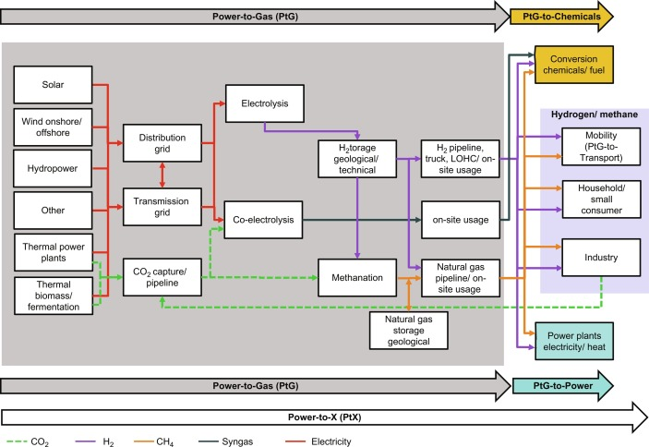
Hydrogen energy storage (Power-to-Gas)
Hydrogen is produced by electrolysis and can be stored in underground caverns, tanks, and gas pipelines
This hydrogen can be used directly as a final energy carrier or converted to methane, synthesis gas, electricity, liquid fuels, or chemicals
Hydrogen can be further converted to methane by reacting with CO2, increasing the stability and energy density of the stored media
Economic feasibility depends on value streams
Notes:
https://www.sciencedirect.com/topics/engineering/power-to-gas

Slide 31
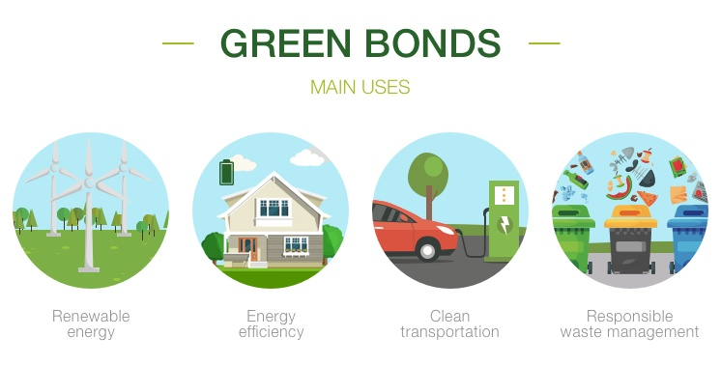
Quiz #2 (Take home)
Why does the EU countries and China take the lead in their NDCs?
How can we achieve the climate target if:
Major carbon emitting countries/regions do not take the lead?
Countries/regions continue to have different types of targets (base year, baseline, intensity, trajectory and fixed level)?
Is it fair for the developing countries to reduce their carbon emissions?
Open with the take home message (most important thing to share)
Q1: Why are we here?
Q2: Says who?
Q3: So what?
Notes:
https://www.iberdrola.com/sustainability/investments-green-bonds

Slide 32
References
[1] Gruber N, Galloway JN. An Earth-system perspective of the global nitrogen cycle. Nature. 2008. 451(7176):293–6.
[2] Gambhir A, Drouet L, McCollum D, Napp T, Bernie D, Hawkes A, et al. Assessing the Feasibility of Global Long-Term Mitigation Scenarios. Energies [Internet]. 2017. 10(1):89.
[3] Basaran ST, Dogru AO, Balcik FB, Ulugtekin NN, Goksel C, Sozen S. Assessment of renewable energy potential and policy in Turkey – Toward the acquisition period in European Union. Environ Sci Policy [Internet]. 2015. 46:82–94.
[4] Hof AF, den Elzen MGJ, Admiraal A, Roelfsema M, Gernaat DEHJ, van Vuuren DP. Global and regional abatement costs of Nationally Determined Contributions (NDCs) and of enhanced action to levels well below 2 °C and 1.5 °C. Environ Sci Policy [Internet]. 2017. 71:30–40.
[5] Rogelj J, Fricko O, Meinshausen M, Krey V, Zilliacus JJJ, Riahi K. Understanding the origin of Paris Agreement emission uncertainties. Nat Commun [Internet]. 2017. 8(1):15748.
[6] Fragkos P, Fragkiadakis K, Paroussos L, Pierfederici R, Vishwanathan SS, Köberle AC, et al. Coupling national and global models to explore policy impacts of NDCs. Energy Policy [Internet]. 2018. 118:462–73.
[7] Duscha V, Denishchenkova A, Wachsmuth J. Achievability of the Paris Agreement targets in the EU: demand-side reduction potentials in a carbon budget perspective. Clim Policy [Internet]. 2019. 19(2):161–74.
[8] Giannousakis A, Baumstark L, Kriegler E. En route to China’s mid-century climate goal: comparison of emissions intensity versus absolute targets. Clim Policy [Internet]. 2020. 20(10):1274–89.
[9] Mohan A, Wehnert T. Is India pulling its weight? India’s nationally determined contribution and future energy plans in global climate policy. Clim Policy [Internet]. 2019. 19(3):275–82.
[10] Paim MA, Salas P, Lindner S, Pollitt H, Mercure JF, Edwards NR, et al. Mainstreaming the Water-Energy-Food Nexus through nationally determined contributions (NDCs): the case of Brazil. Clim Policy [Internet]. 2020. 20(2):163–78.
[11] Rochedo PRRR, Soares-Filho B, Schaeffer R, Viola E, Szklo A, Lucena AFPP, et al. The threat of political bargaining to climate mitigation in Brazil. Nat Clim Chang [Internet]. 2018. 8(8):695–8.
[12] Anderson JJ, Rode D, Zhai H, Fischbeck P. Will We Always Have Paris? CO 2 Reduction without the Clean Power Plan. Environ Sci Technol [Internet]. 2018. 52(5):2432–3.
[13] Mayer A. National energy transition, local partisanship? Elite cues, community identity, and support for clean power in the United States. Energy Res Soc Sci [Internet]. 2019. 50(July 2018):143–50.
[14] Silva Herran D, Fujimori S, Kainuma M. Implications of Japan’s long term climate mitigation target and the relevance of uncertain nuclear policy. Clim Policy [Internet]. 2019. 19(9):1117–31.
[15] Sprake D, Vagapov Y, Lupin S, Anuchin A. Housing estate energy storage feasibility for a 2050 scenario. In: 2017 Internet Technologies and Applications (ITA) [Internet]. IEEE; 2017 Sep p. 137–42.

